Slide 1
Computer Networks Lab

Slide 2
Lab 5:
Socket Programming:
TCP and UDP Concurrent Servers

Slide 3

Outline
1.
2.
3.
4.
Iterative servers Fork()
Concurrent servers
Handling Child Servers

Slide 4
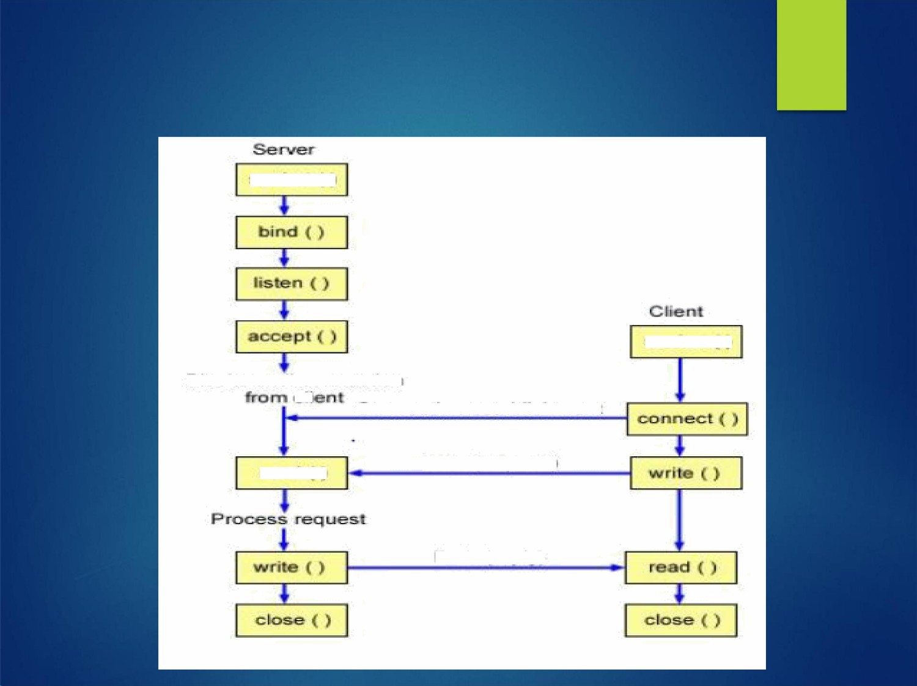

TCP Client Server Interaction
Socket( )
read
Data (request)
Data ( reply)

Slide 5
Iterative Server
Server is iteratively waiting for clients. Iterative servers are fairly simple and are
suitable for transactions that do not last long.
When a client calls connect function the server gets connected with it and provides it
services.
During this period no more client can connect with the server because it is tied up with a single client.

Slide 6

Iterative servers
create a socket- Socket()
bind to the desired port- Bind()
put the socket in passive mode - listen() while
(1)
{
Accept the next connection-Accept()
while (client requests)
{
read the request from the client - read()/recv()
send a reply to client- write()/send()
}
}close the client socket- close()
process request

Slide 7

Fork() System Call
When the server receives and accepts the client’s connection, it forks a copy of itself called child and lets the child handle the client
The prototype of "fork" call is:
pid_t fork(void);
where the definition of "pid_t" is given in
<sys/types> include file, and the include file
<unistd.h> contain the declaration of "fork" system call.
When successful, "fork" returns the process ID of the child process in the parent process, and it returns a "0" in the child process.

Slide 8
Fork() System Call
By checking the return value from "fork", a process can easily determine if it is a parent or child process. A process can generate multiple child processes, but each child process has only oneparent.
What happens when a fork system call is made?
✔ When a fork system call is made, the operating system generates a copy of the parent process which becomes the child process.
✔ The OS will pass to the child process most of the parent’s system information (e.g. open file descriptors, environment information etc.)

Slide 9

Fork() System Call
Some information, however, is unique to the child process.
Process ID
Different parentprocess ID Process times
Own copy of file descriptors
Resource utilization (initialized to zero)

Slide 10

Fork()
pid_t new_pid; new_pid = fork(); switch(new_pid) { case
-1 : /* Error */ break; case 0 : /* I am child */ break;
default : /* I am parent */ break;
}

Slide 11
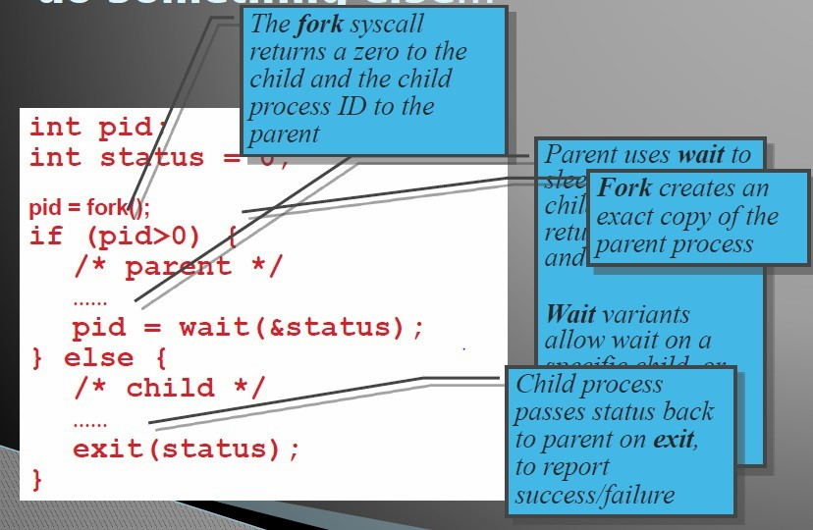
But we want the child process to do something else…

Slide 12

Concurrent servers
Concurrent servers can handle multiple clients at same time.
Concurrent servers fork a child to handle each client.
After the establishment of connection sever calls fork and creates child to serve the client. Then parent closes the connected socket.

Slide 13

Concurrent servers
bind to the desired port
put the socket in listen mode (passive) while
(1)
{
Accept the next client connection
fork() // create a new process to handle the request if (child) // i.e if return value of the previous fork is zero {
this part of the code will only be executed by the child process
communicate with the client socket process client request
close client socket
exit // you can safely terminate the child process-> parent is still listening
for new clients
}
else // i,e. for the parent process
{
close client socket as parent will not handle it
}
}

Slide 14

Thank You

